Slide 1

Presentation on
BLOGMAZE A full stack web application
By: Jasdev Singh UID: O23MCA110027
Masters of Computer Application, Chandigarh University

Slide 2
INTRODUCTION 3
TECH STACK 4
KEY FEATURES 5-6
DESIGN 7-15
CONCLUSION 16
Agenda

Slide 3

Introduction
In today’s digital era, online platforms play crucial role which enable people to share their knowledge, ideas and opinions. From out of those, blogs have established themselves as the most widely recognized and powerful platforms for self-expression and public communication. Blogging has always provided an immediate and powerful way for individuals to publish content.

Slide 4
Tech Stack
HTML, CSS, ReactJS
RestAPIs
NodeJS & Express
MySQL
GitHub

Slide 5
Key Features
To develop a scalable and user-friendly blogging platform.
To enable to Create new blog posts, using rich text editor along with formatting.
To allow users to read blog posts by categories for better navigation and relevance.
To enable users to Edit, and Delete their own blog posts.
To Disable edit and delete feature if user is not the owner of blog post.
To implement authentication features such as login and logout to secure user data, along with password encryption.

Slide 6
Key Features - continue
To integrate Text-to-Speech (TTS) capabilities, making content accessible to visually impaired users or those who prefer listening.
To provide a “Get Summary” feature that offers AI-generated summaries of blog content for faster reading.
To display related blog recommendations under each category to promote content engagement.
Display User information , Posted Date for blog in real time with each blog.
Connect Application’s creator through Gmail, LinkedIn and Facebook

Slide 7
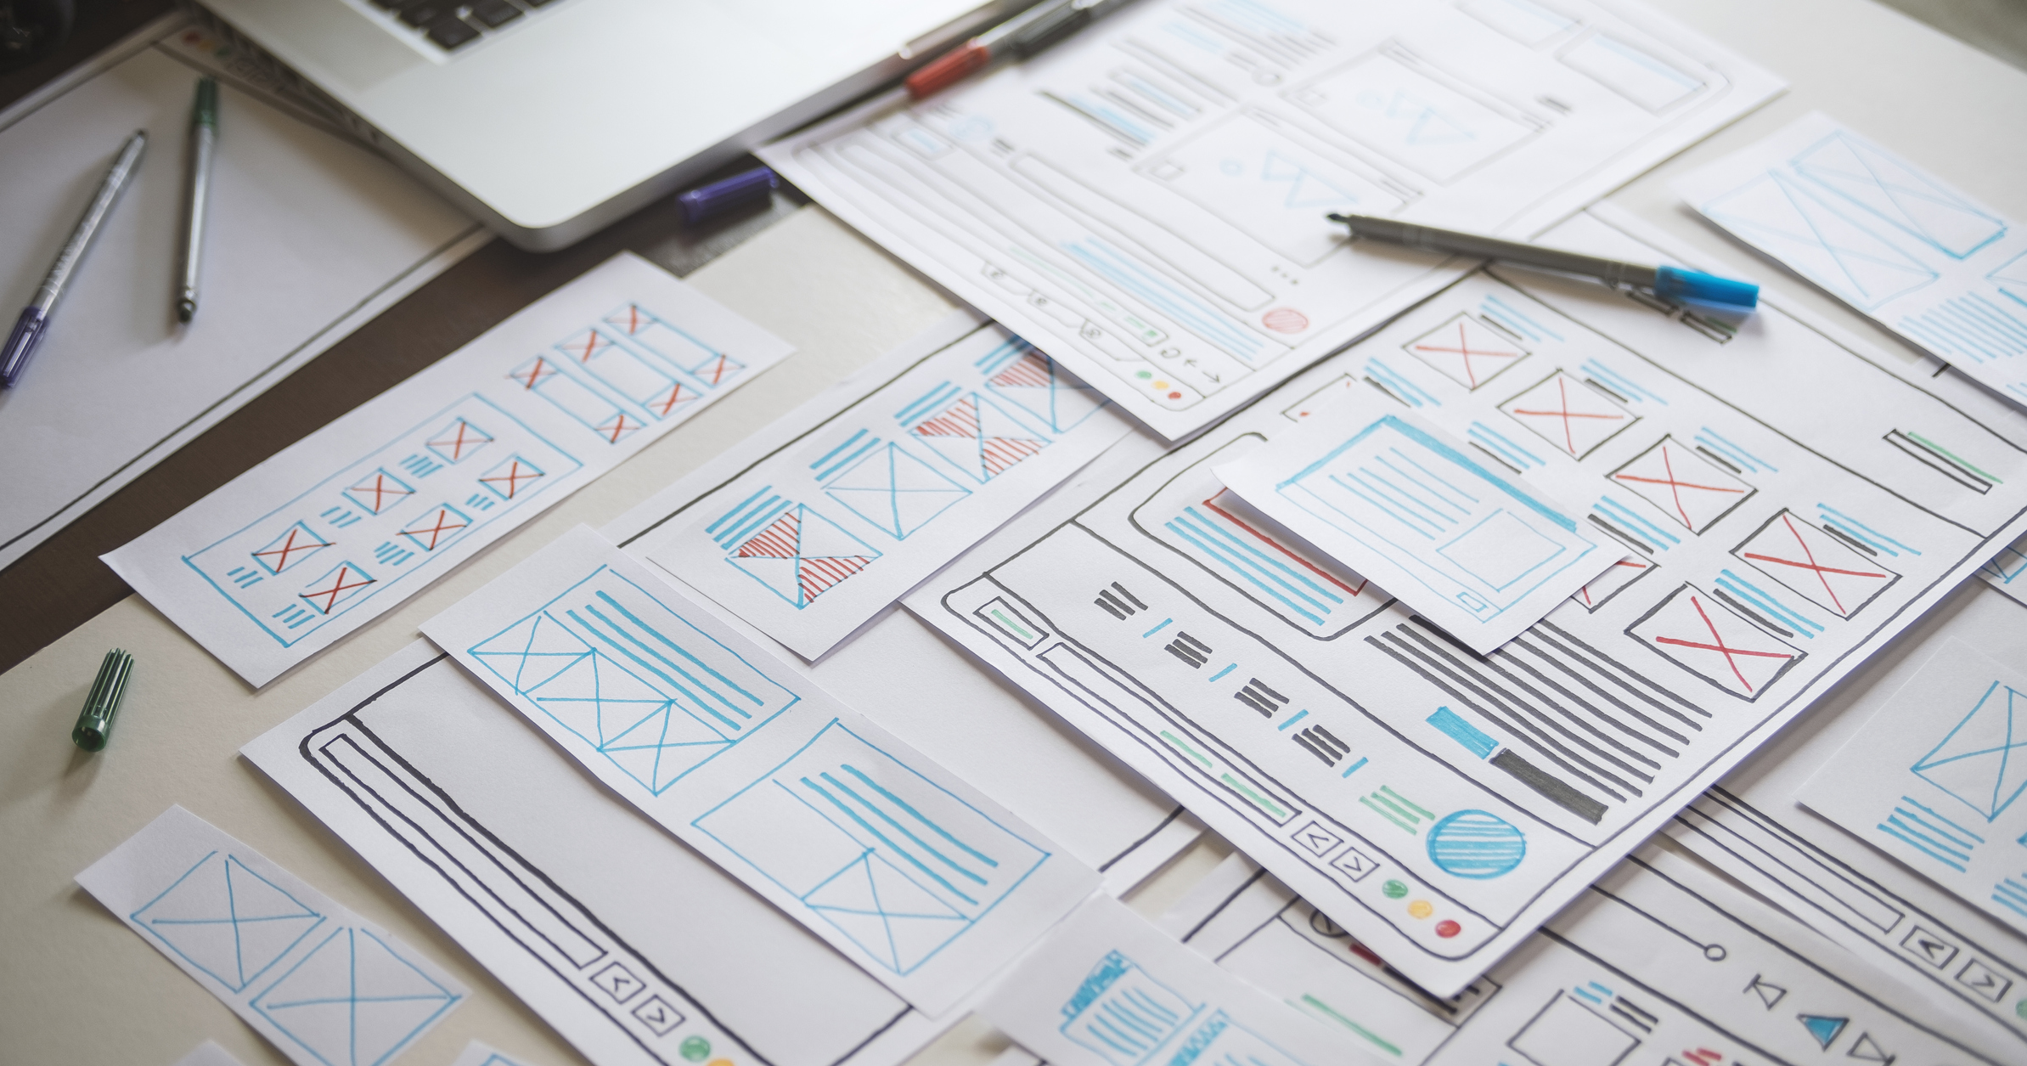
DESIGN & LAYOUT
BLOGMAZE APPLICATION DESIGN

Slide 8
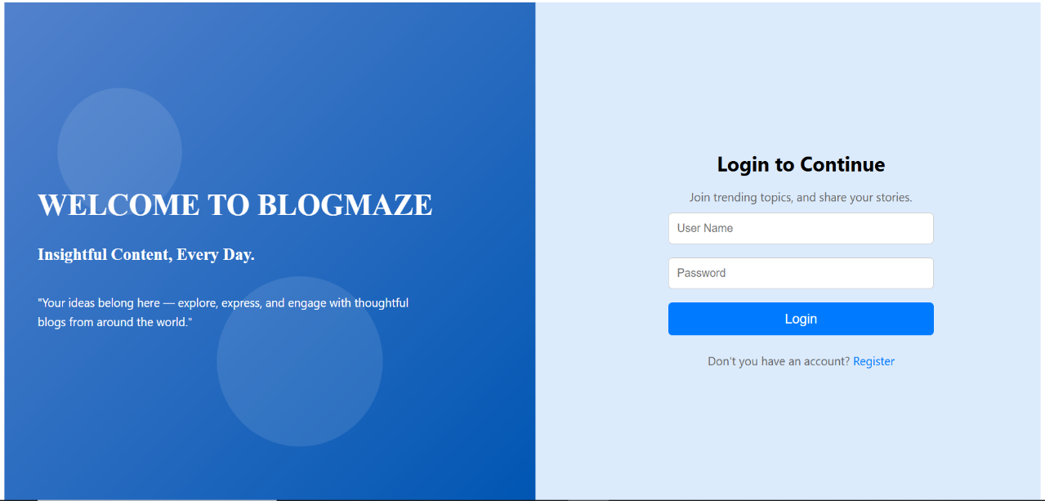
Login Page
Blogmaze – A full stack blog web application

Slide 9
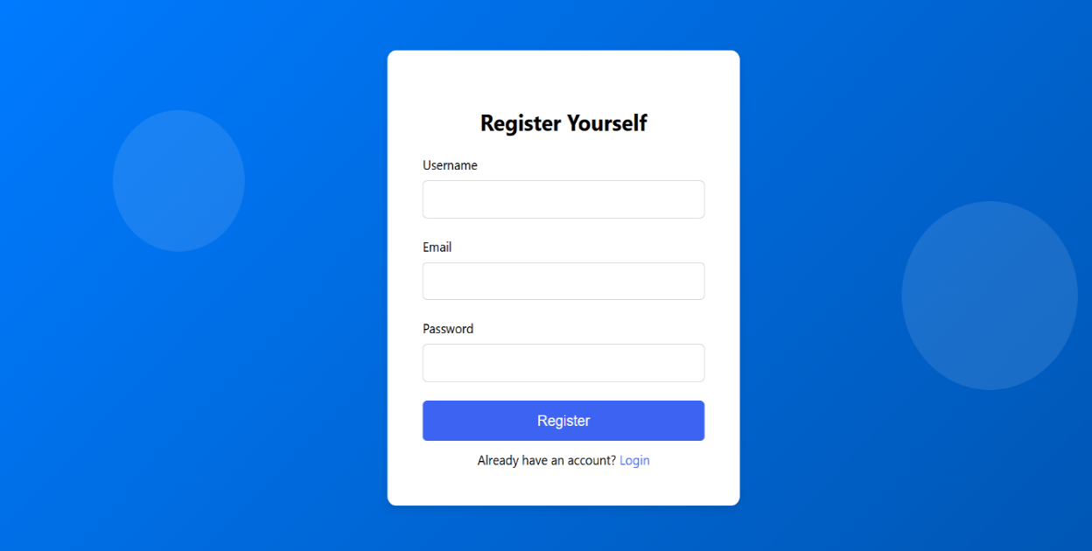
Registration Page
User navigates to register page from login page when register hyperlink is clicked.
Blogmaze – A full stack blog web application

Slide 10
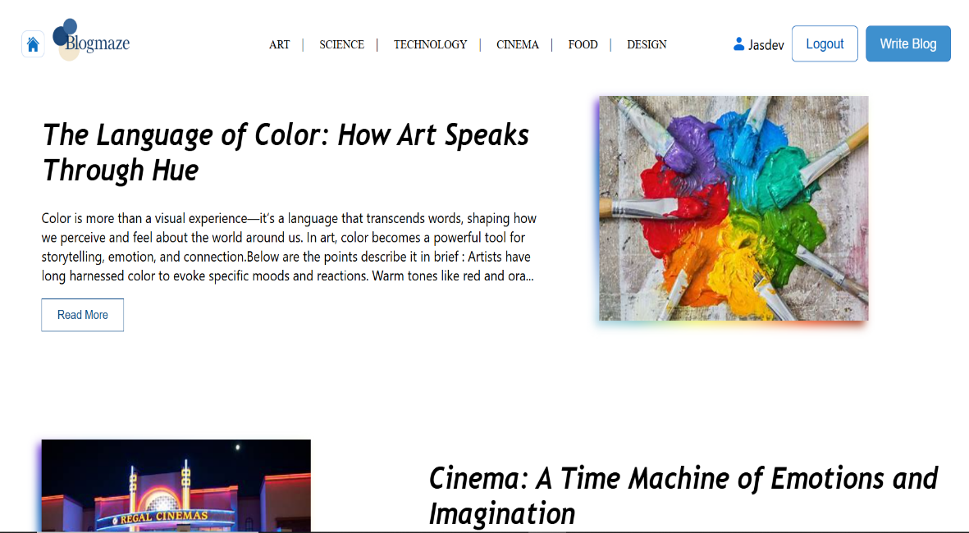
Home Page
User navigates to homepage from login page when provides valid credentials and click login button
Blogmaze – A full stack blog web application

Slide 11
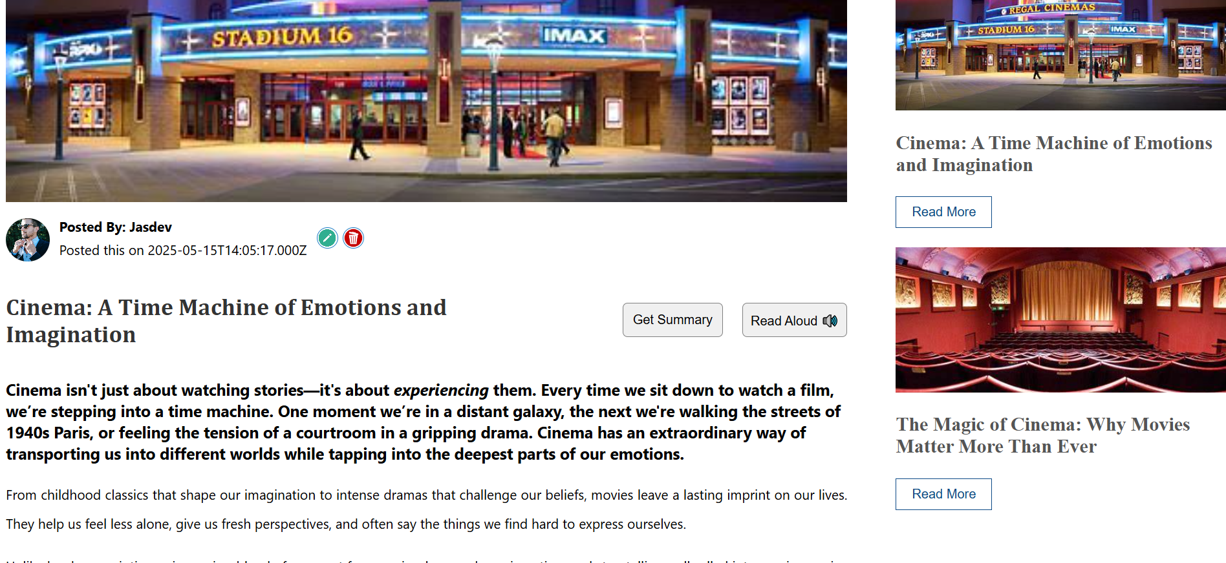
Single Post Page
When User click Read More for Home page system will navigate to this page and allows user to read complete post
Blogmaze – A full stack blog web application

Slide 12
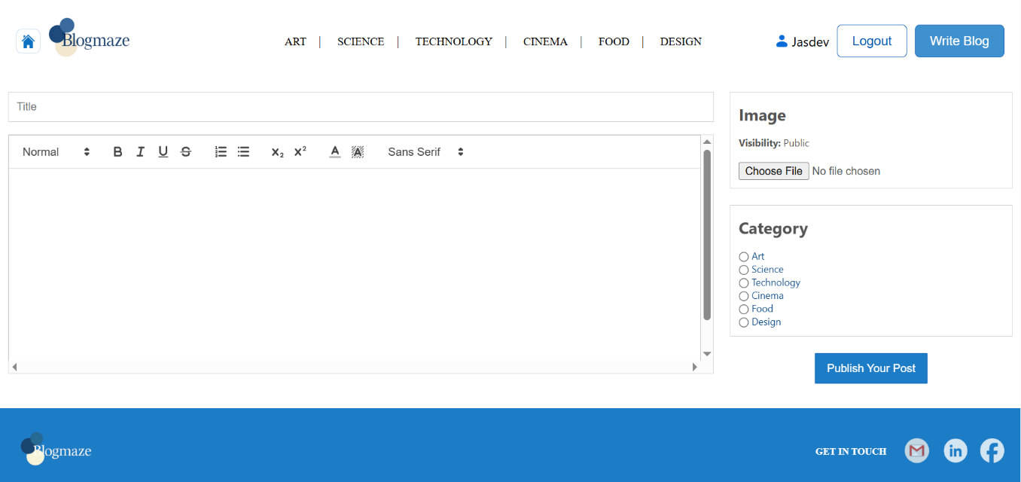
Write Page
User can navigate to this page by clicking “Write Blog” Button from navigation bar
Blogmaze – A full stack blog web application

Slide 13
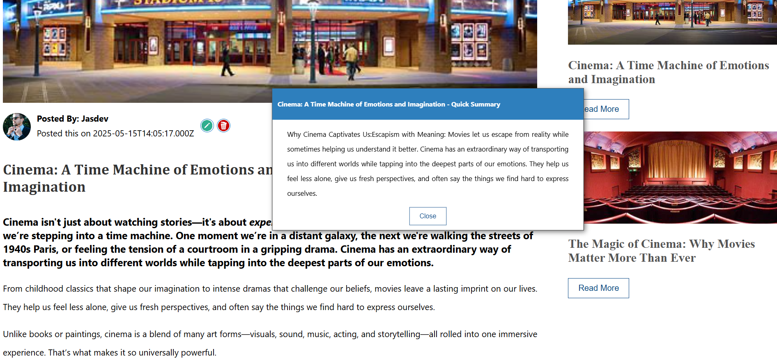
Summary Popup page
On click “Get Summary” from single post page it will show quick summary of post
Blogmaze – A full stack blog web application

Slide 14
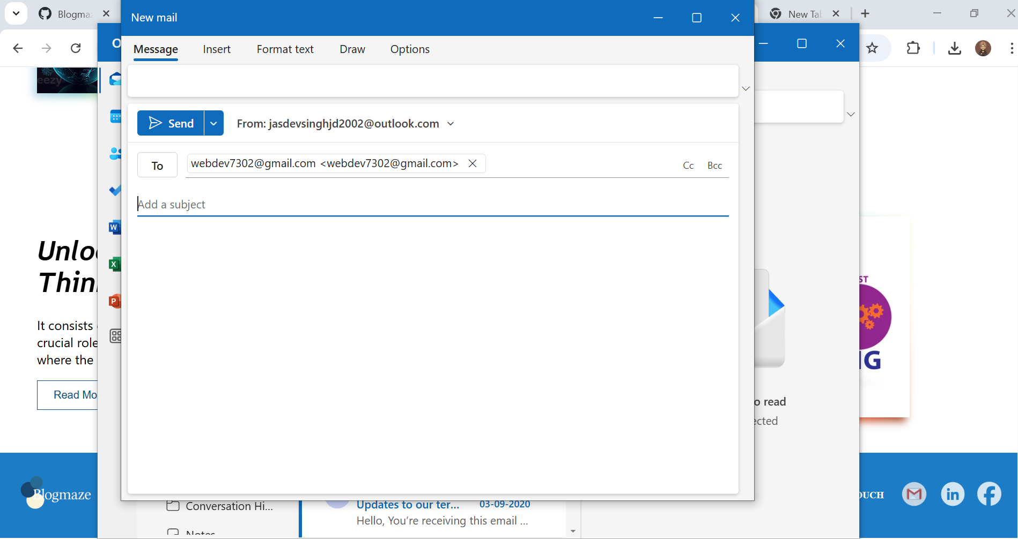
Footer Elements
User can connect with application creator through Gmail, LinkedIn and Facebook.
Blogmaze – A full stack blog web application

Slide 15
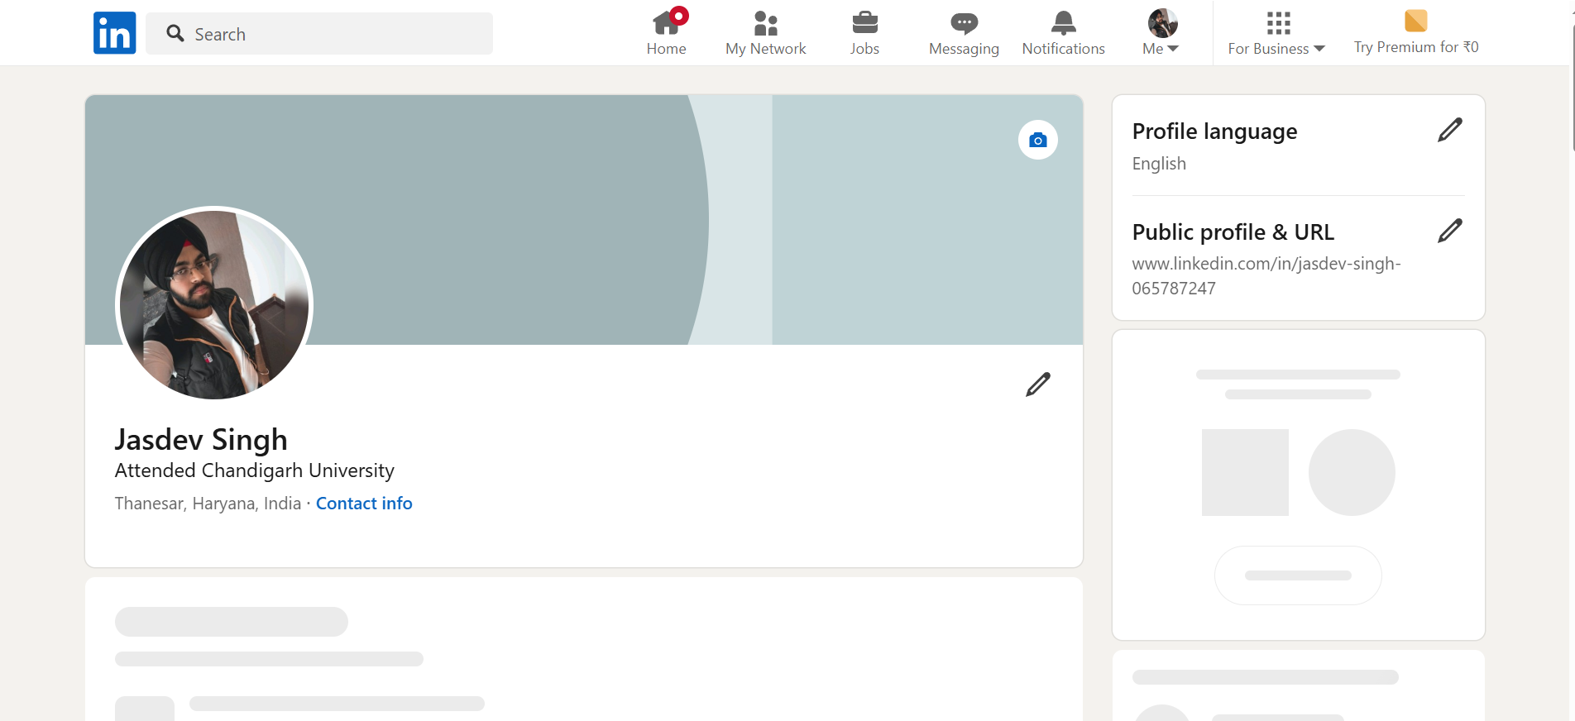
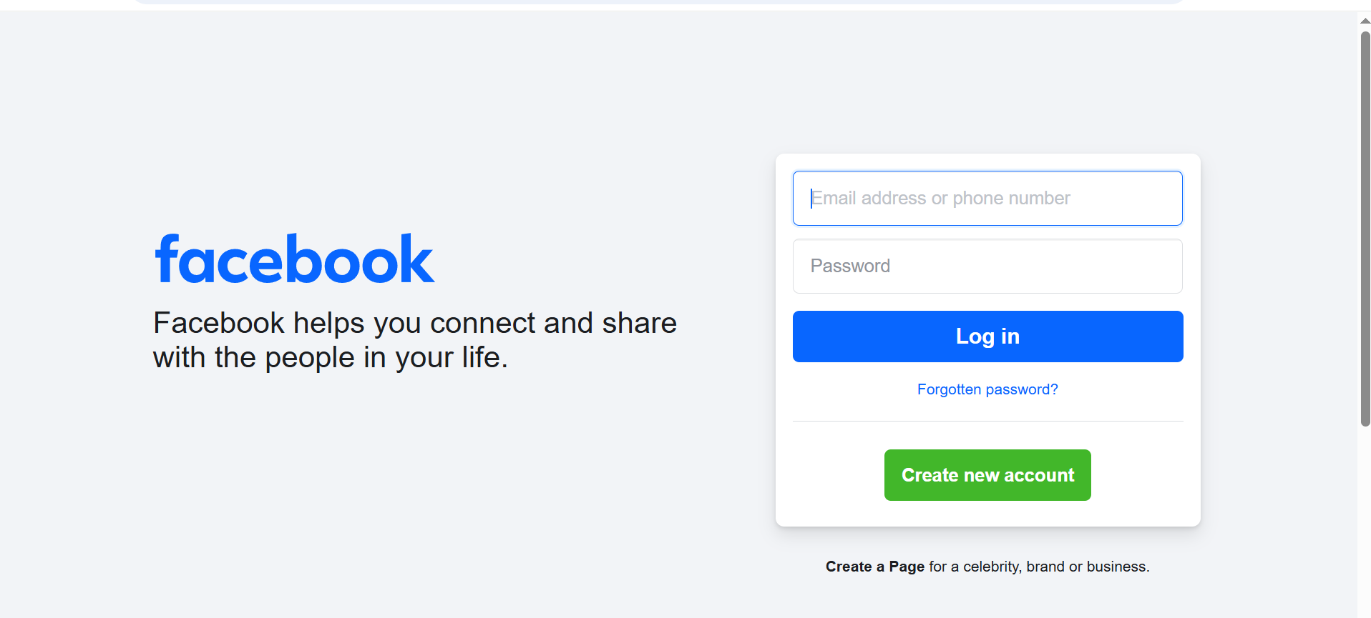
Footer Elements
User can connect with application creator through Gmail, LinkedIn and Facebook.
Blogmaze – A full stack blog web application

Slide 16


Conclusion
This blog web application is an individual college project which focus on delivering a fully functional user-focused blog web application for both writing and reading blog posts. The goal of the project was to provide a good blogging experience that includes a clean modern user interface, backend functionality, and several useful features, including authentication, categorization of content, summarization with AI, and text to speech. During this project, I made connections with full stack development skills, and the different services I used including: React.js for the frontend, Node.js and Express for the backend and MySQL for data storage.
Blogmaze – A full stack blog web application

Slide 17


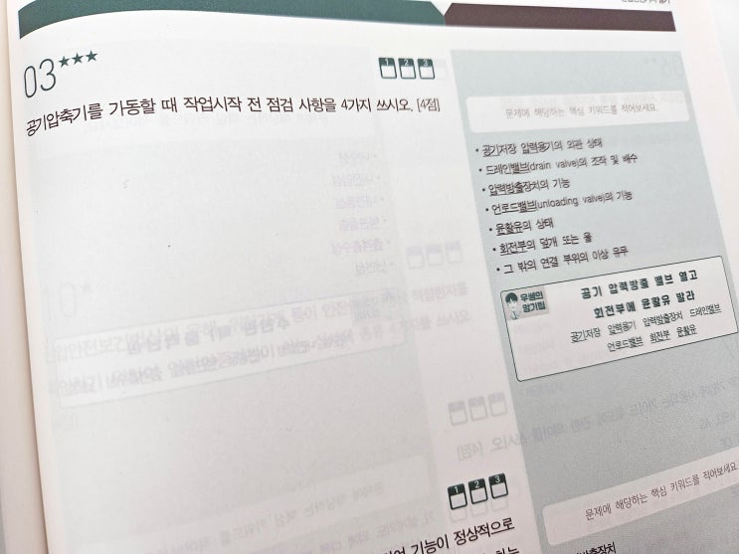

Thank you
Submitted By: Jasdev Singh
UID: O23MCA110027

